Slide 1

Careers Information Evening
16th September 2024

Slide 2
Welcome
Mrs Kerwood
Assistant Headteacher

Slide 3


Personal Development
Developing the Whole Child
VISION: To give our pupils the best opportunities here at Toynbee so that they leave school equipped with all the tools they need to be successful beyond school.
1. Aiming for academic excellence to open doors at further education and work:
  All lessons will strive to challenge our pupils to exceed expectations
2. Becoming informed, well-rounded people who are able to thrive in modern Britain by respecting all members of society and understanding how to live safe, healthy lives:
Culture & Ethos
Pastoral Curriculum
Academic Curriculum
Beyond the Curriculum
CAREERS

Slide 4
Personal Development
CAREERS
Termly Careers weeks:
Curriculum subjects devote a lesson to linking their subject to careers
Tutor programme:
Personal Development sessions may have Careers links
Assembly programme:
Themed – dedicated Careers assembly when timely and colleges coming in for year 11
1:1 Careers Advisor: Offered to all KS4 pupils
Work Experience: for all year 10 pupils
Links with colleges and local university: taster days, external speakers, educational visits
Links with LEP and Eastleigh Council: wider world opportunities inc. apprenticeships
Careers Fair – 15th October: colleges, industries and vocational careers

Slide 5
Support and Guidance
Mrs Vallance
Year 10 Guidance Manager

Slide 6
Careers
Mrs Shaw
Careers Leader

Slide 7



Year 10 Parents Information Evening
Post 16 options
Year 10 – Work Experience
Careers Leader – Mrs Shaw

Slide 8


Post 16 Options
If you live in England, you have to stay in education or training until the age of 18
There are lots of options available so its important to understand what is the best route by exploring all the possibilities
Notes:
To guide our pupils to navigate the range of opportunities available to them so that they can achieve the necessary skills and experience for them to succeed.
To provide them with Equality of opportunity and to engage all the school community to help them to succeed.
To teach them that “anything is possible”

Slide 9

The benefits of studying post 16
Gaining more qualifications after 16 is a good idea as more qualifications mean more job choices.
You are, therefore, more likely to find a job you enjoy rather than taking the risk of having to do unskilled work.
Better qualifications will give you a chance to earn more money – and, as research shows, have greater job satisfaction.
Notes:
To guide our pupils to navigate the range of opportunities available to them so that they can achieve the necessary skills and experience for them to succeed.
To provide them with Equality of opportunity and to engage all the school community to help them to succeed.
To teach them that “anything is possible”

Slide 10


What are the options ?
Option 1 : Stay in full-time education – A levels, BTEC,
T levels, vocational and technical qualifications, exam retakes
Or
Option 2: Combine work with study – Apprenticeship, supported internships
Notes:
To guide our pupils to navigate the range of opportunities available to them so that they can achieve the necessary skills and experience for them to succeed.
To provide them with Equality of opportunity and to engage all the school community to help them to succeed.
To teach them that “anything is possible”

Slide 11
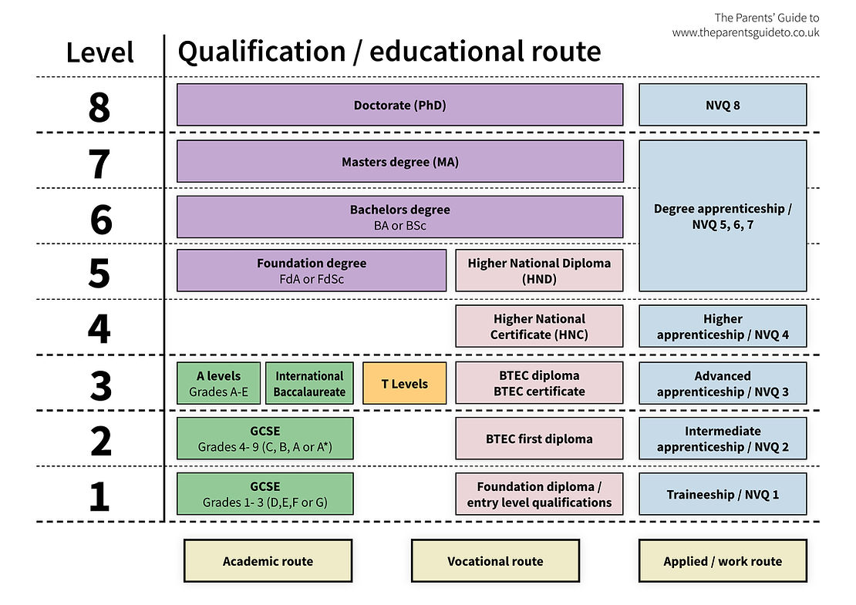
Understanding your next steps
Notes:
To guide our pupils to navigate the range of opportunities available to them so that they can achieve the necessary skills and experience for them to succeed.
To provide them with Equality of opportunity and to engage all the school community to help them to succeed.
To teach them that “anything is possible”

Slide 12

Option 1: Staying in FTE: A-Levels
You can carry on studying subjects you took for GCSE to a higher level or pick new ones you may not have done before like economics, law or psychology
You can take 3 - 4 very different subjects you are interested in - keep your career options open or choose more closely related subjects if you need them for a specific career
Duration | 2 years
Level of Study | 3
Entry requirements | Typically, Five GCSEs at grade 9-4, including English and Maths
Assessment | Mostly exams at the end of the course
Grades Awarded | A* - E
Leads to | University or college courses, higher and degree apprenticeships
https://youtu.be/BHKFrXMCHII
Notes:
To guide our pupils to navigate the range of opportunities available to them so that they can achieve the necessary skills and experience for them to succeed.
To provide them with Equality of opportunity and to engage all the school community to help them to succeed.
To teach them that “anything is possible”

Slide 13
Option 1: Staying in FTE: BTECs
At Level 3 Applied general qualifications are better known as BTECs and are equivalent to A levels,
A mix of classroom-based learning with the chance to get some practical skills
Duration | 2 years
Level of Study | 3
Entry requirements | Typically, Five GCSEs at grade 9-4, including English and Maths
Assessment | Typically, a mix of coursework and exams
Grades Awarded | Points Awarded
Leads to | University/college, apprenticeship, work
Gives you a broad overview of working in a specific sector, like business, media, engineering, leisure or science and technology
Can take a mixture of A levels and BTECs (single award BTEC is equivalent to an A level) or some BTECs are double
https://youtu.be/L7TYTSIG8JU
Notes:
To guide our pupils to navigate the range of opportunities available to them so that they can achieve the necessary skills and experience for them to succeed.
To provide them with Equality of opportunity and to engage all the school community to help them to succeed.
To teach them that “anything is possible”

Slide 14
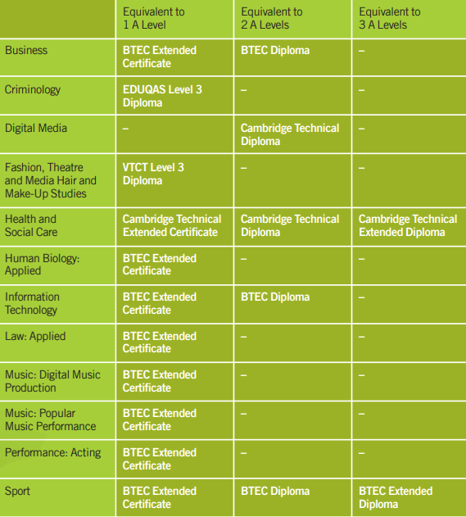
BTEC – vocational course
Example of the types of BTECs – peter Symonds website

Slide 15
Option 1: Staying in FTE: T-Levels
Designed in partnership with employers to give you the skills and knowledge to get on in the workplace. You'll combine classroom learning with real work placements. 1 T Level is the equivalent of 3 A levels
You’ll spend 80% of your time in the classroom and 20% at work (At least 45 days on industry placement equivalent to 315 hours)
Duration | 2 years
Level of Study | 3
Entry requirements | Typically, Five GCSEs at grade 9-4, including English and Maths
Assessment | Exams, projects and practical assignments
Grades Awarded | Points Awarded
Leads to | Work, higher and degree apprenticeships, college and university courses
https://youtu.be/7rua65bHjMw
Notes:
To guide our pupils to navigate the range of opportunities available to them so that they can achieve the necessary skills and experience for them to succeed.
To provide them with Equality of opportunity and to engage all the school community to help them to succeed.
To teach them that “anything is possible”

Slide 16
Option 1: Staying in FTE: Vocational & Technical Qualifications
These courses teach you the practical skills and knowledge for a particular area of employment. They can prepare you for a broad employment sector, like engineering or travel and tourism, or for a specific job like a chef or a hairdresser.
You'll learn in real situations in college, for example in a college restaurant or a salon that is open to the public. You may also have the chance to go out on a work placement with an employer.
Duration | 1 or more years
Level of Study | Level 1 & 2 take 1 year each, L3 takes 2 years
Entry requirements | Course dependent
Assessment | Can include coursework, skills tests and exams
Awarded | City and Guilds; National Vocational Qualifications (NVQs)
Leads to | Further study, training, professional development programmes or work
Notes:
To guide our pupils to navigate the range of opportunities available to them so that they can achieve the necessary skills and experience for them to succeed.
To provide them with Equality of opportunity and to engage all the school community to help them to succeed.
To teach them that “anything is possible”

Slide 17
Option 1: Staying in FTE: Exam Retakes
retake English and Maths GSCEs whilst also studying other level 2 subjects for example, criminology or Law that can then lead you onto a level 3 course
If you didn't get the results you wanted, you can resit some of your courses or sign up for some new qualifications
Duration | 1 year
Level of Study | 2
Entry requirements | 16+
Assessment | Exams but some level 2 courses offer coursework elements too
Awarded | Level 2 qualifications = GCSE
Leads to | Higher level or degree apprenticeship, further education, higher education, work
Notes:
To guide our pupils to navigate the range of opportunities available to them so that they can achieve the necessary skills and experience for them to succeed.
To provide them with Equality of opportunity and to engage all the school community to help them to succeed.
To teach them that “anything is possible”

Slide 18

Option 2: Combine Work & Study
Gain practical skills, get work experience and a qualification that employers need through the following :
Apprenticeship, Supported internship
Notes:
To guide our pupils to navigate the range of opportunities available to them so that they can achieve the necessary skills and experience for them to succeed.
To provide them with Equality of opportunity and to engage all the school community to help them to succeed.
To teach them that “anything is possible”

Slide 19
Option 2: Combine Work & Study – Apprenticeships
Apprenticeships combine practical on-the-job skills training with off-the-job learning. You'll get training that is relevant to your job and be paid a salary
You’ll spend 80% of your time in the workplace and 20% off-the-job
with some study in a college, training centre or Institute of Technology (IoT)
Duration | A minimum of 1 year but progress to a degree apprenticeship
Level of Study | L2 – GCSE L3 – A level L4,5,6,7 – Foundation level Degree, L6 & 7 Master’s degree
Entry requirements | Will be dependent on the industry, job role and apprenticeship level
Assessment | Most apprenticeships work towards one or more qualifications. These qualifications correspond to the level of apprenticeship
Grades Awarded | Dependent on the type of qualification taken
Leads to | Work, next level of apprenticeship, further education, higher education
Apprenticeships are real jobs which include learning elements
https://vimeo.com/613415806
Notes:
To guide our pupils to navigate the range of opportunities available to them so that they can achieve the necessary skills and experience for them to succeed.
To provide them with Equality of opportunity and to engage all the school community to help them to succeed.
To teach them that “anything is possible”

Slide 20
Option 2: Combine Work & Study – Supported Internships
You'll spend most of your time on placements with an employer, learning skills for work. You'll also get help from a tutor and a job coach in college or with a specialist provider
For young people who need extra support to get a job
Duration | A minimum of 6 months
Level of Study | Level 2
Entry requirements | Aged 16-24 with an Education Health and Care Plan
Assessment | Dependent on course
Grades Awarded | GCSE English and maths
Leads to | Work, apprenticeship
unpaid work placement of at least 6 months
support from a qualified job coach. You may be eligible for Access to work Funding
Notes:
To guide our pupils to navigate the range of opportunities available to them so that they can achieve the necessary skills and experience for them to succeed.
To provide them with Equality of opportunity and to engage all the school community to help them to succeed.
To teach them that “anything is possible”

Slide 21
Thinking about the next steps –help for pupils
If you have a career in mind, find out if you need to continue to study certain subjects, for example maths if you want to do Engineering.
If you are not sure what you would like to do, then looking at careers linked to subjects you enjoy might help you unlock a future career path.
Think about learning styles ( classroom versus practical or a combination of both) as this will help you decide what type of course is right for you?
'stay broad’ and do a broad range of subjects if they are unsure so they can decide later!
Go to open events, careers fairs to find out more about the options available to you
Notes:
To guide our pupils to navigate the range of opportunities available to them so that they can achieve the necessary skills and experience for them to succeed.
To provide them with Equality of opportunity and to engage all the school community to help them to succeed.
To teach them that “anything is possible”

Slide 22

Careerspilot www.careerpilot.org.uk

Slide 23



Useful websites
www.nationalcareers.service.gov.uk/explore-your-education-and-training-choices
www.nationalcareers.service.gov.uk/discover-your-skills-and-careers
www.careermap.co.uk/careerometer
www.parentalguidance.org.uk
Advice, tips and guidance on all aspects from apprenticeships to colleges and higher education, to completing applications and interviews.
www.apprenticeships.gov.uk/parents/their-career
A guide to what apprenticeships are, how you can support your young person to apply and what skills and experience will be relevant.
Notes:
To guide our pupils to navigate the range of opportunities available to them so that they can achieve the necessary skills and experience for them to succeed.
To provide them with Equality of opportunity and to engage all the school community to help them to succeed.
To teach them that “anything is possible”

Slide 24

Open Events – 2024
College/Sixth Form | Open evenings | Website
Barton Peveril Sixth Form College | 25th & 26th of September 2024: 4.30pm – 8.30pm (Register online) | www.barton-peveril.ac.uk/
Peter Symonds College | 1st & 2nd October 2024 - awaiting booking form | www.psc.ac.uk
Eastleigh College | 23rd October 2024 5pm- 7pm | www.shcg.ac.uk
Richard Taunton Sixth Form College | 19th September 2024 6 – 8pm 13th November 2024 6 – 8pm | www.richardtaunton.ac.uk
Itchen | 17th October 2024 – evening times TBC Saturday 19th October 2024 –timings TBC | www.itchen.ac.uk
Sparsholt College | Saturday 5 October 2024 - timings TBC | www.sparsholt.ac.uk
Southampton City College | 10th October 2024 5pm-7pm | www.shcg.ac.uk
Fareham College | 23rd October 2024 5pm-7pm | www.shcg.ac.uk
Totton | 15th October 2024 5pm-7pm | www.totton.ac.uk
Notes:
To guide our pupils to navigate the range of opportunities available to them so that they can achieve the necessary skills and experience for them to succeed.
To provide them with Equality of opportunity and to engage all the school community to help them to succeed.
To teach them that “anything is possible”

Slide 25
Year 10 Careers programme
Focus - Experience the world of work
Personal Development lessons (PSHCE) focus on work experience , CVs and Interview skills
National Apprenticeship week – Feb 2025
National Careers week – March 2025
Mock Interview Day – June 2025
College taster days - June 2025
Work experience week – see next slide

Slide 26
Work Experience week
Monday 30th June – 4th July 2025
Notes:
To guide our pupils to navigate the range of opportunities available to them so that they can achieve the necessary skills and experience for them to succeed.
To provide them with Equality of opportunity and to engage all the school community to help them to succeed.
To teach them that “anything is possible”

Slide 27
The benefits of Work Experience
Experience of the workplace
Team working & communication
Meeting deadlines
Gain valuable experience to add to your CV
Time management
Build on employability skills
Building confidence

Slide 28

Employer Feedback from last year
We absolutely loved having Leo with us last week, he was incredibly keen, kind and helpful
It was an absolute pleasure having the 4 pupils on site last week. In fact, the office is quiet and empty without them!
He is an incredible young man who I believe after spending a week in his company has a super bright future
She is bright, keen and enthusiastic young person asking many questions and showing genuine interest in Joinery
I have been really impressed with your can-do attitude and the way you have taken every opportunity offered to you and given things a go
95% of pupils had work experience in year 10 in 2024

Slide 29

Work Experience placements last year

Slide 30
Work Experience - School
In school we will focus on:
The skills employers are looking for
Finding a work experience placement
CVs and interview skills
Speakers from School talk on virtual Work experience
Notes:
To guide our pupils to navigate the range of opportunities available to them so that they can achieve the necessary skills and experience for them to succeed.
To provide them with Equality of opportunity and to engage all the school community to help them to succeed.
To teach them that “anything is possible”

Slide 31
Work Experience - How parents can help?
Can you or a family member provide work experience?
Look for work experience possibilities in your local area
Plan ahead - schools in our area have the same week!
Encourage your child to come and speak to me if they are struggling to find a placement.
Check the Employer has public liability
Notes:
To guide our pupils to navigate the range of opportunities available to them so that they can achieve the necessary skills and experience for them to succeed.
To provide them with Equality of opportunity and to engage all the school community to help them to succeed.
To teach them that “anything is possible”

Slide 32
Work Experience - School
School will send out a letter with more details about work experience and a link to an electronic form for parents/carers to complete :
Details of the work placement
Parents/carer consent
Notes:
To guide our pupils to navigate the range of opportunities available to them so that they can achieve the necessary skills and experience for them to succeed.
To provide them with Equality of opportunity and to engage all the school community to help them to succeed.
To teach them that “anything is possible”

Slide 33
Work Experience - School
We shall also check Employer Public Liability
We collate all information regarding pupil’s work experience
We arrange visits/phone calls during the placements
Notes:
To guide our pupils to navigate the range of opportunities available to them so that they can achieve the necessary skills and experience for them to succeed.
To provide them with Equality of opportunity and to engage all the school community to help them to succeed.
To teach them that “anything is possible”

Slide 34
Work Experience - Pupils
Will complete a work experience journal
Reflect on what new skills they have learnt during their Personal development lessons
Notes:
To guide our pupils to navigate the range of opportunities available to them so that they can achieve the necessary skills and experience for them to succeed.
To provide them with Equality of opportunity and to engage all the school community to help them to succeed.
To teach them that “anything is possible”

Slide 35
Work Experience
Deadline for Work experience placements is Friday 4th April 2024
Notes:
To guide our pupils to navigate the range of opportunities available to them so that they can achieve the necessary skills and experience for them to succeed.
To provide them with Equality of opportunity and to engage all the school community to help them to succeed.
To teach them that “anything is possible”

Slide 36
Any Questions ?
Upcoming Events
Information talk on Apprenticeships & T levels on the 1st of October from 1800-1700 – letter out this week with a link to book place
Post 16 options Careers Fair 15th of October 2024 from 1730 -1845
College open events – dates published in school’s newsletter
Careers Leader – Mrs Shaw

